Slide 1
Main
IMM Credit and Solutions, Inc.
IMM Credit and Solutions is a rapidly growing private credit firm. IMM Credit and solutions is a wholly owned subsidiary of IMM Holdings, Inc., which is a leading comprehensive Private Capital Management firm in Korea with strong value creation capability.
View more→

Slide 2
Company
동일(배경 이미지만 변경)

Slide 3
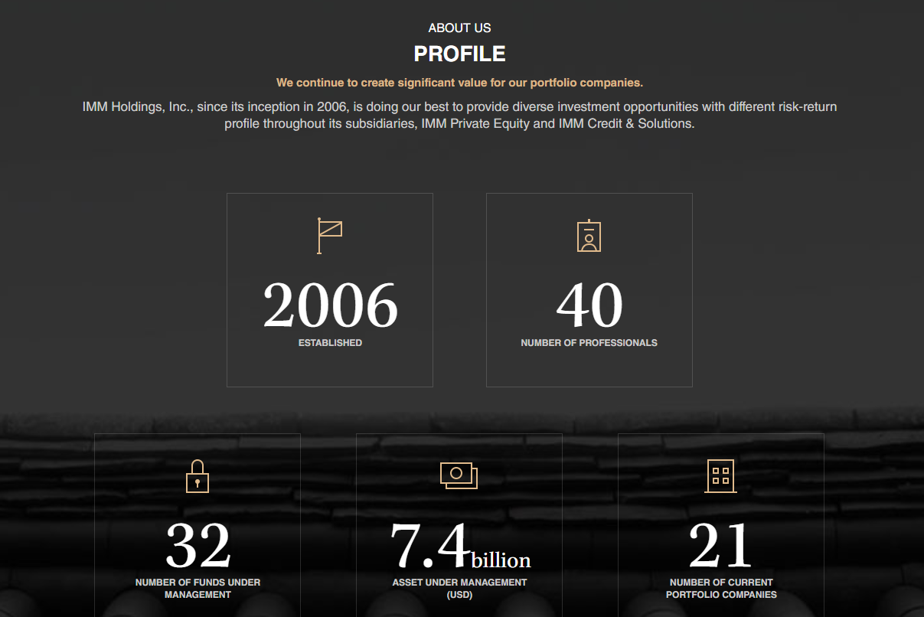
Company
ABOUT US
PROFILE
Established in September 2020, IMM Credit & Solutions has a good command of both credit-focused strategy and solution-focused strategy, which are pioneering areas in local market. Established: 2020
Number of Professional: 10
Number of Funds under management: 4
AUM: 1.1 billion (USD)
Number of current portfolio companies: 4 (아이콘 동일/ 모바일로도 한페이지에 보이게)

Slide 4
Company
이전 slide에 이어서 내용 추가
IMM 홀딩스 페이지 > Portfolio 의 OVERVIEW 부분 이미지 하단 텍스트 전부 *18p. 참조

Slide 5
Company
동일

Slide 6
Company
삭제

Slide 7
Company
삭제

Slide 8
Company
삭제

Slide 9
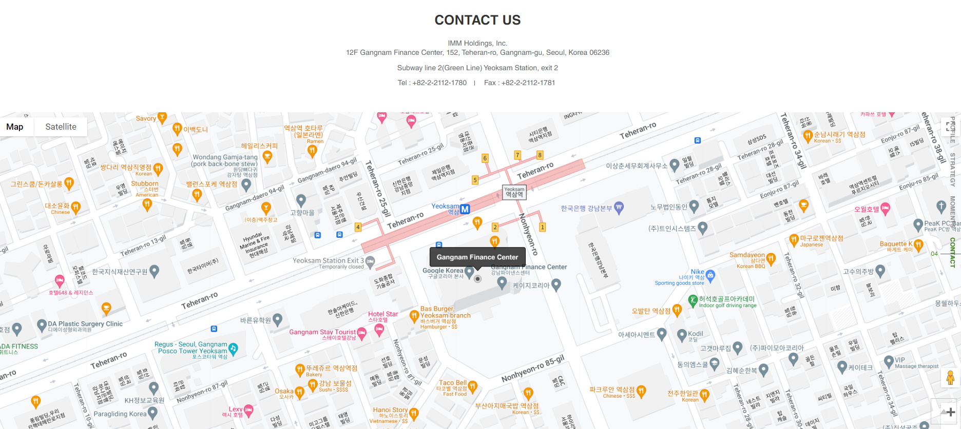
Company
동일
IMM Hodlings만 IMM Credit and Solutions 로 변경
삭제
유지(가독성 높게)
Family Site:
IMM HOLDINGS &
IMM FOUNDATION

Slide 10
Value
삭제

Slide 11
Value
삭제

Slide 12
Value
삭제

Slide 13
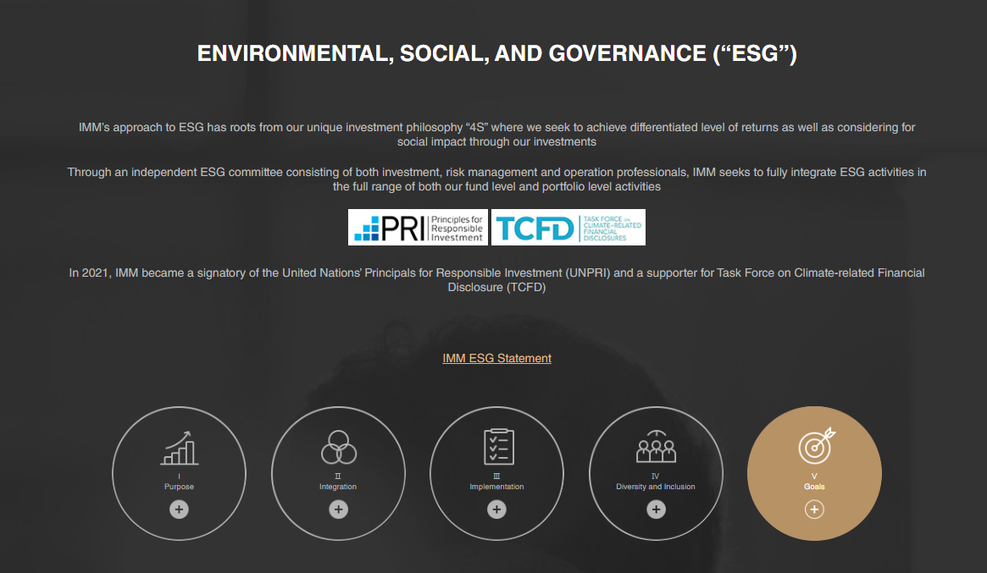
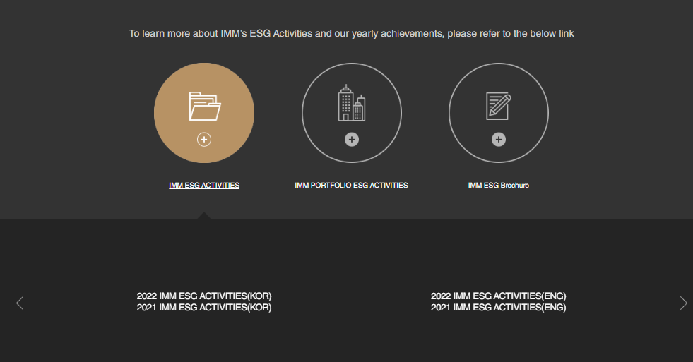
Value
삭제

Slide 14
Value
삭제

Slide 15
Team
삭제

Slide 16
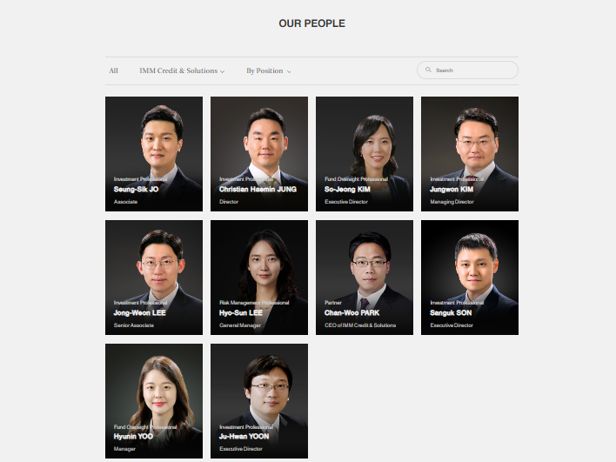
Team
삭제

Slide 17
Portfolio
삭제

Slide 18
Portfolio
삭제

Slide 19
Portfolio
삭제

